Slide 1
Network Security

Slide 2
Network Security
Our Goals:
understand principles of network security:
  cryptography and its many uses beyond “confidentiality”
  authentication
  message integrity
security in practice:
  security in application, transport, network, link layers

Slide 3
Do we need network security?
Internet and WWW computing standards (IP, HTTP, etc) are public
  Therefore, intruders know about the types of messages being sent around the Internet
The Internet is open and pervasive
The Internet has many connecting components
  A message sent between two computer will often pass through many others
  Can we trust the others?

Slide 4
Network Security
Computer security
  The generic name for the collection of tools designed to protect data and to thwart hackers
Network/Internet security
  Consists of measures to, deter, prevent, detect and correct security violations that involve the transmission of information

Slide 5
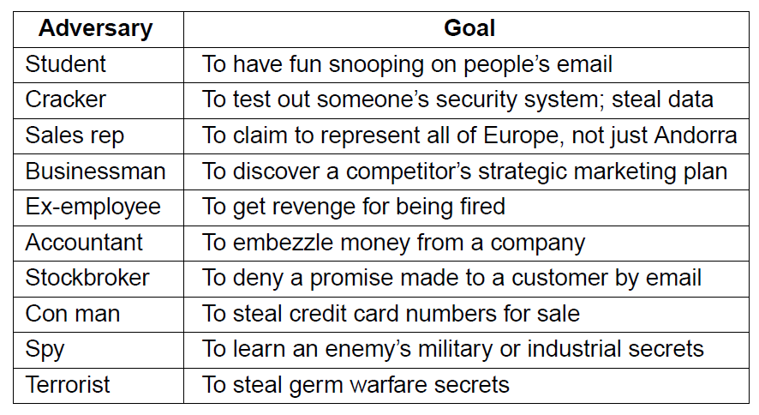
Network Security
Some people who cause security problems and why.

Slide 6
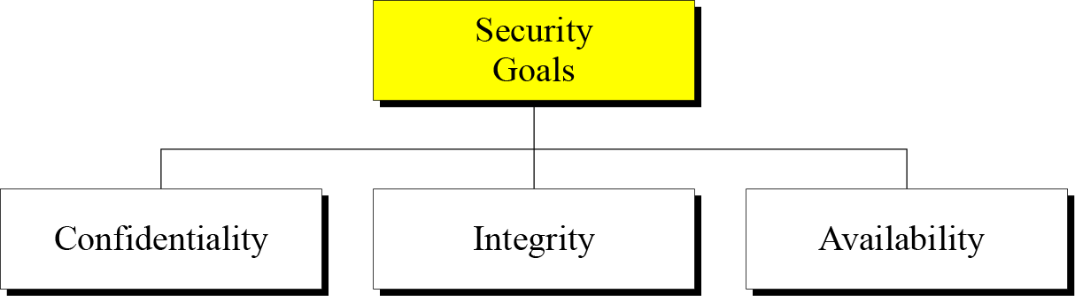
Network Security Goals

Slide 7
Network Security Goals
Confidentiality is probably the most common aspect of information security. We need to protect our confidential information. An organization needs to guard against those malicious actions that endanger the confidentiality of its information.
Integrity: Information needs to be changed constantly. Integrity means that changes need to be done only by authorized entities and through authorized mechanisms.
Availability: The information created and stored by an organization needs to be available to authorized entities. Information needs to be constantly changed, which means it must be accessible to authorized entities.
.

Slide 8
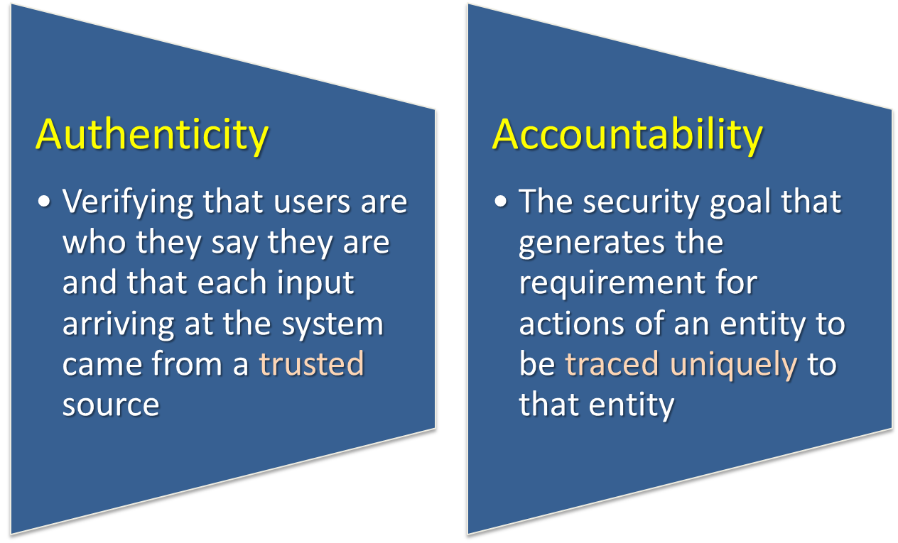
Possible additional concepts:

Slide 9
OSI Security Architecture
ITU-T Recommendation X.800, Security Architecture for OSI describes a systematic way of defining the requirements for security and characterizing the approaches to satisfying those requirements. Focus
Security attack
  Any action that compromises the security of information owned by an organization
Security mechanism
  A process (or a device incorporating such a process) that is designed to detect, prevent, or recover from a security attack
Security service
  A processing or communication service that enhances the security of the data processing systems and the information transfers of an organization
  Intended to counter security attacks, and they make use of one or more security mechanisms to provide the service

Slide 10
Security Attacks
A means of classifying security attacks, used both in X.800 and RFC 4949, is in terms of passive attacks and active attacks
A passive attack attempts to learn or make use of information from the system but does not affect system resources
An active attack attempts to alter system resources or affect their operation

Slide 11
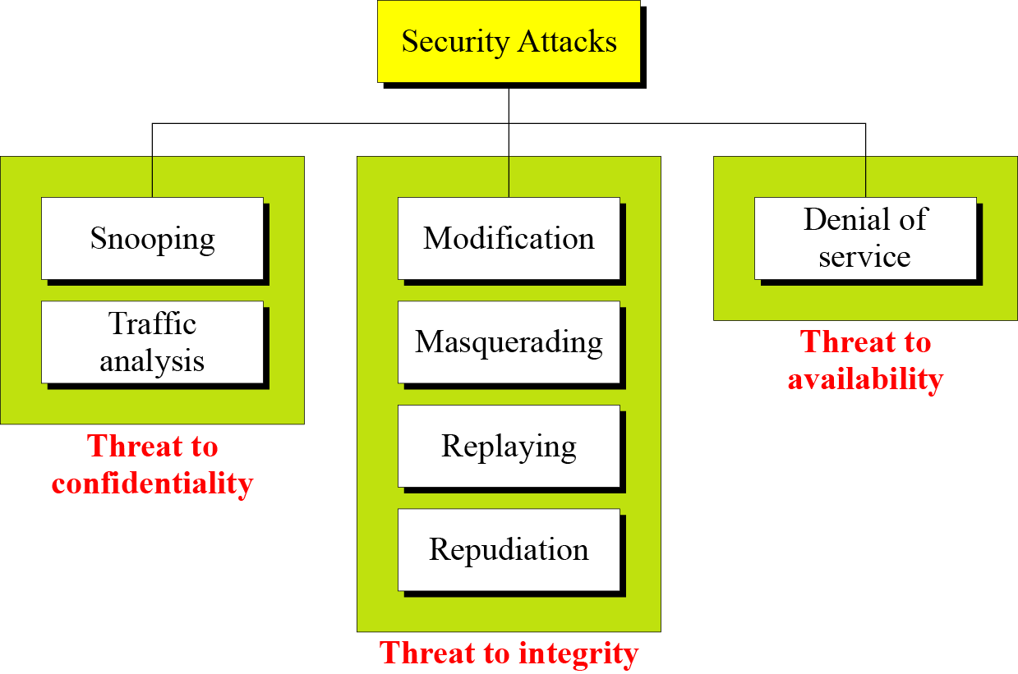
ATTACKS
The three goals of security⎯confidentiality, integrity, and availability⎯can be threatened by security attacks.

Slide 12
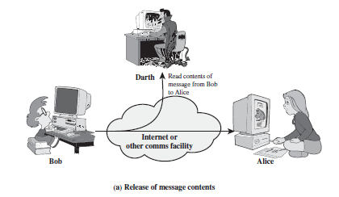
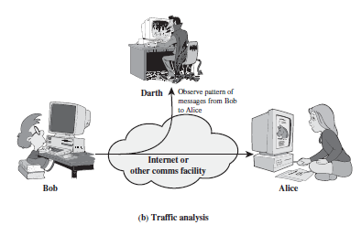
PASSIVE ATTACKS
Snooping refers to unauthorized access to or interception of data.
Traffic analysis refers to obtaining some other type of information by monitoring online traffic.

Slide 13
Active Attacks
Modification means that the attacker intercepts the message and changes it.
Masquerading or spoofing happens when the attacker impersonates somebody else.
Replaying means the attacker obtains a copy
of a message sent by a user and later tries to replay it.
Repudiation means that sender of the message might later deny that she has sent the message; the receiver of the message might later deny that he has received the message.

Slide 14
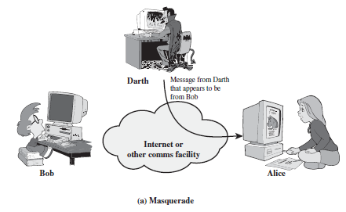
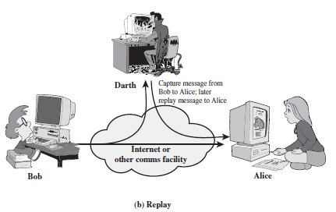
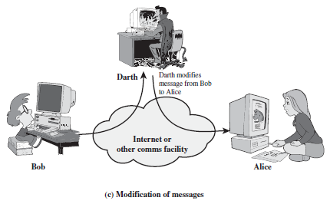
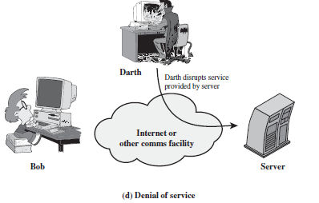
Active attacks

Slide 15
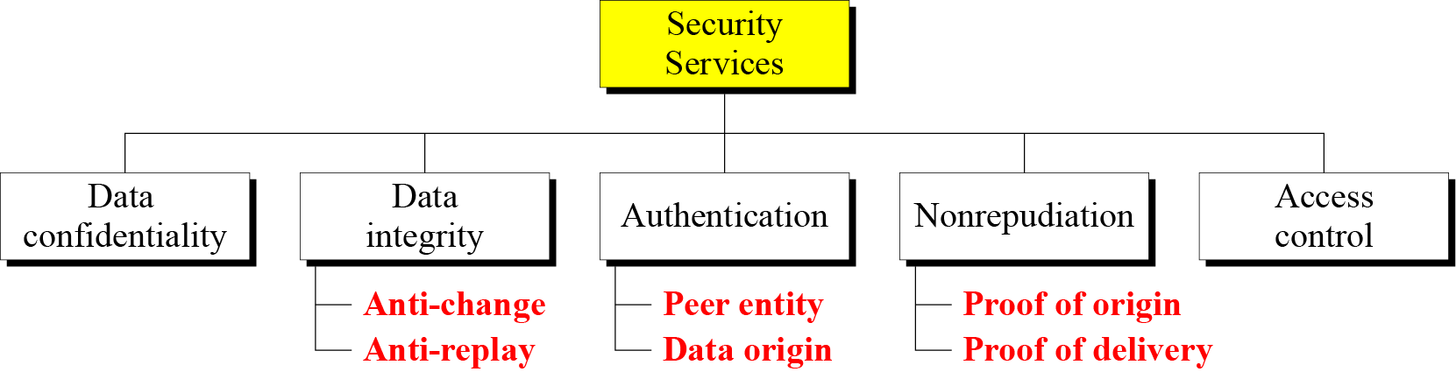
SERVICES AND MECHANISMS
ITU-T provides some security services and some mechanisms to implement those services. Security services and mechanisms are closely related because a mechanism or combination of mechanisms are used to provide a service.
X.800 divides these services into five categories and fourteen specific services

Slide 16
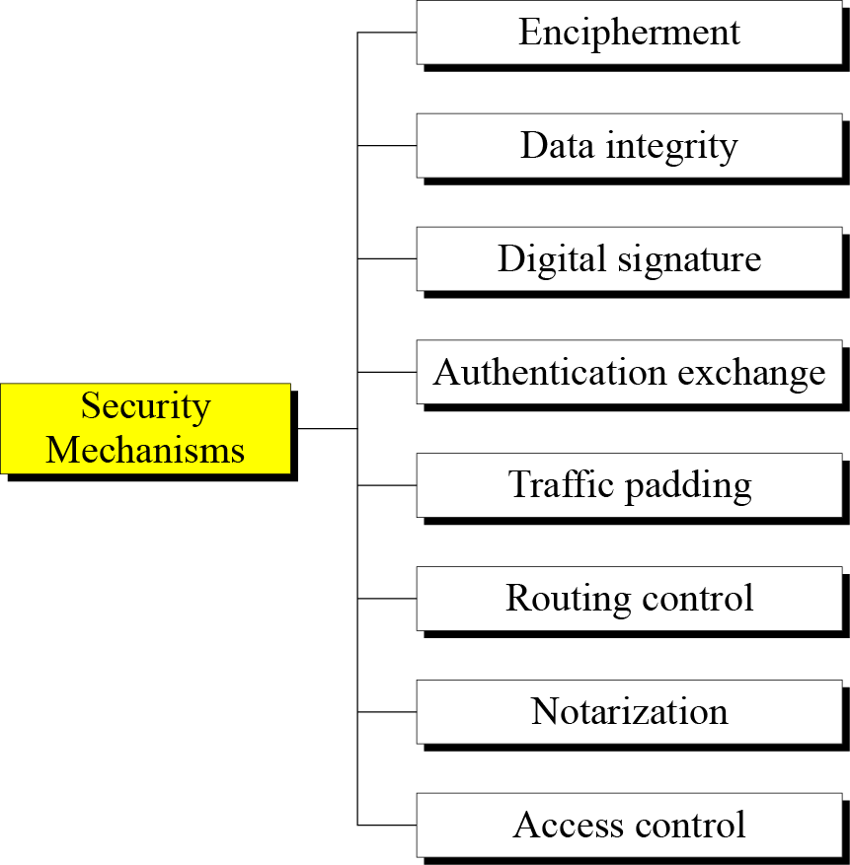
Security Mechanisms (X.800)
Specific security mechanisms: incorporated into the appropriate protocol layer in order to provide some of the OSI security services

Slide 17
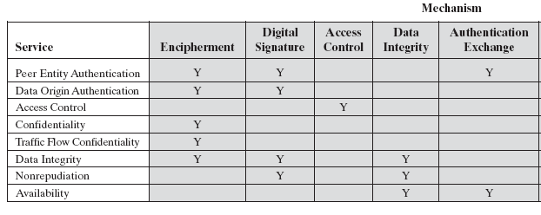
Relationship Between Security Services and Mechanisms

Slide 18
Outline
Introduction
  What is network security?
  Why is network security important?
  What are the requirements for a secure network?
  An introduction to Cryptography
Symmetric Key Cryptography
Public Key Cryptography
Authentication
Integrity
Security in Internet protocol stack

Slide 19
Cryptography
From the Greek words: ‘Cryptos’ (= secret) and ‘Grafien’ (= writing)
From ancient times to around 30 years ago: essentially private communications for personal, political and military matters
Today: study and application of techniques relying on the existence of hard problems
A lot of historic uses of Cryptography...

Slide 20
Cryptography
Introduction
Substitution ciphers
Transposition ciphers
One-time pads
Fundamental cryptographic principles

Slide 21
Cryptographic Algorithms
Symmetric encryption: Used to conceal the contents of blocks or streams of data of any size, including messages, files, encryption keys and passwords.
Asymmetric encryption: Used to conceal small blocks of data, such as encryption keys and hash function values, which are used in digital signatures.
Data integrity algorithms: Used to protect blocks of data, such as messages, from alteration.
Authentication protocols: These are schemes based on the use of cryptographic algorithms designed to authenticate the identity of entities.

Slide 22
Terminology
Plaintext original message
Ciphertext encrypted or coded message
Encryption convert from plaintext to ciphertext (enciphering)
Decryption restore the plaintext from ciphertext (deciphering)
Key information used in cipher known only to sender/receiver
Cipher a particular algorithm (cryptographic system)
Cryptography study of algorithms used for encryption
Cryptanalysis study of techniques for decryption without
knowledge of plaintext
Cryptology areas of cryptography and cryptanalysis

Slide 23
Characterizing Cryptographic Systems
Operations used for encryption:
Substitution replace one element in plaintext with another
Transposition re-arrange elements
Product systems multiple stages of substitutions and transpositions
Number of keys used:
Symmetric sender/receiver use same key (single-key, secret-key, shared-key, conventional)
Public-key sender/receiver use dierent keys (asymmetric)
Processing of plaintext:
Block cipher process one block of elements at a time
Stream cipher process input elements continuously

Slide 24
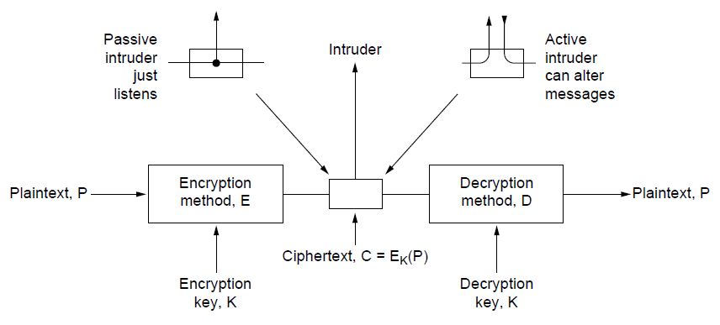
Encryption Model
The encryption model (for a symmetric-key cipher).

Slide 25
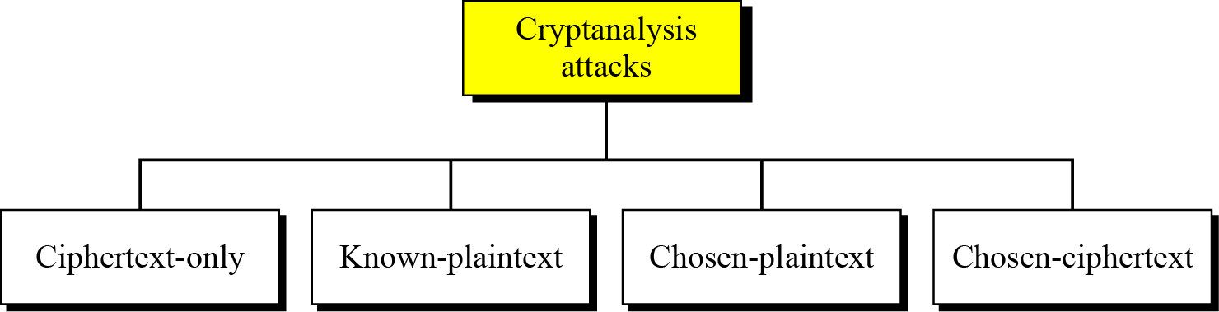
Cryptanalysis
As cryptography is the science and art of creating secret codes, cryptanalysis is the science and art of breaking those codes.
Cryptanalysis attacks

Slide 26
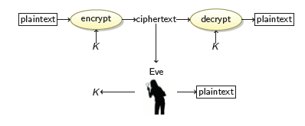
Cryptanalysis (Cont.)
Ciphertext-only attack
We have: the ciphertext of several messages that have been encrypted with the same key, K.
We recover: the plaintexts, or K.

Slide 27
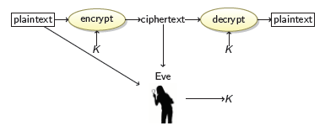
Cryptanalysis (Cont.)
Known-Plaintext Attack
We have: the ciphertexts and corresponding plaintexts of several messages, all encrypted with the same key K.
We recover: the key K.

Slide 28
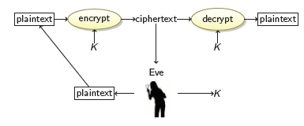
Cryptanalysis (Cont.)
Chosen-Plaintext Attack
We have: the ciphertext of several messages that have been encrypted with the same key K, such that we get to choose the plaintexts.
We recover: the key K.

Slide 29
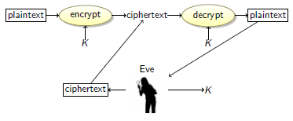
Cryptanalysis (Cont.)
Chosen-Ciphertext Attack
We have: the plaintext of several messages that have been encrypted with the same key K, such that we get to choose the ciphertexts.
We recover: the key K.

Slide 30
Substitution ciphers
A substitution cipher replaces one symbol with another. Substitution ciphers can be categorized as either monoalphabetic ciphers or polyalphabetic ciphers.
A substitution cipher replaces one symbol with another.
Topics:
Monoalphabetic Ciphres
Polyalphabetic Ciphers

Slide 31
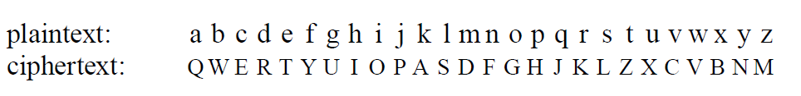
Substitution Ciphers
Monoalphabetic substitution

Slide 32
Polyalphabetic encryption
n monoalphabetic cyphers, M₁,M₂,…,M_{n}
Cycling pattern:
  e.g., for n=4: M₁,M₃,M₄,M₃,M₂; M₁,M₃,M₄,M₃,M₂;
For each new plaintext symbol, use subsequent monoalphabetic pattern in cyclic pattern
  ‘dog’: d from M₁, o from M₃, g from M₄
Key: the n ciphers and the cyclic pattern

Slide 33
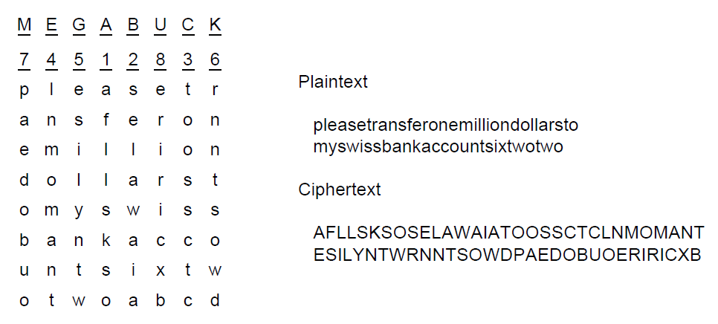
Transposition Ciphers
A transposition cipher

Slide 34
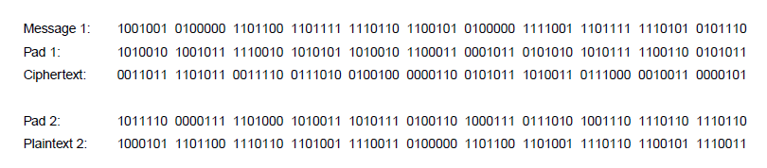
One-Time Pads (1)
The use of a one-time pad for encryption and the possibility of getting any possible plaintext from the ciphertext by the use of some other pad.

Slide 35
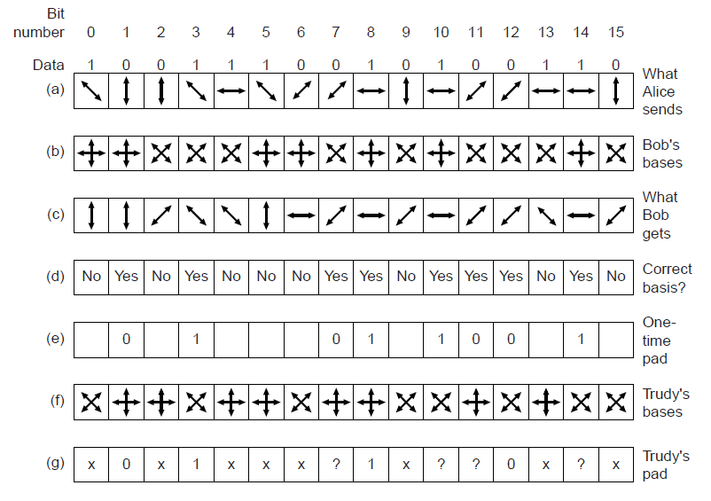
One-Time Pads (2)
An example of quantum cryptography

Slide 36
Two types of symmetric ciphers
Block ciphers
  Break plaintext message in equal-size blocks
  Encrypt each block as a unit
Stream ciphers
  encrypt one bit at time

Slide 37
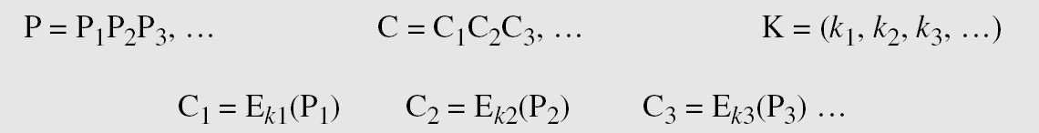
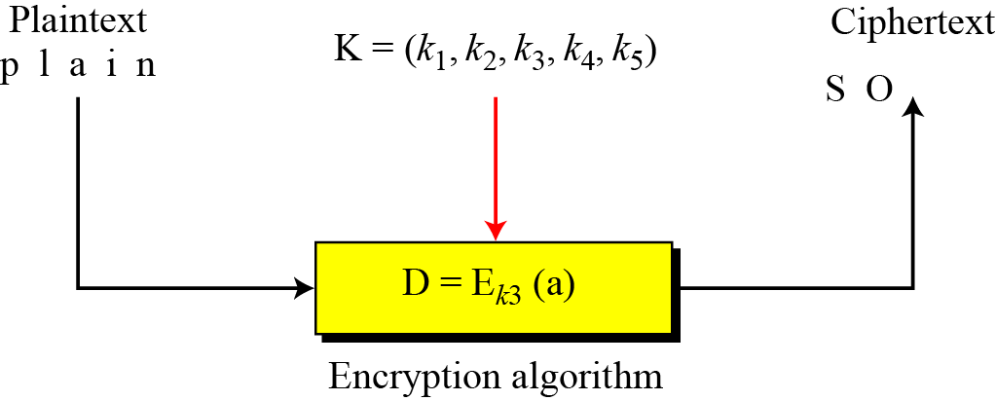
Stream Ciphers
Call the plaintext stream P, the ciphertext stream C, and the key stream K.
Figure Stream cipher

Slide 38
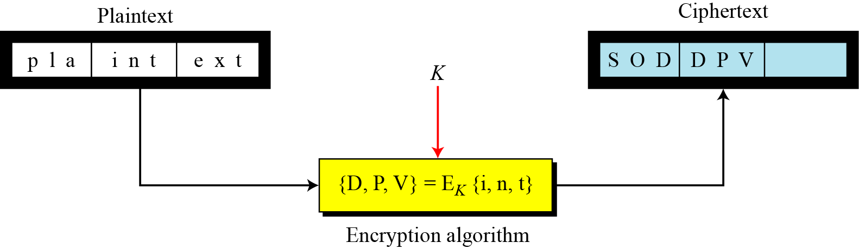
Block Ciphers
In a block cipher, a group of plaintext symbols of size m (m > 1) are encrypted together creating a group of ciphertext of the same size. A single key is used to encrypt the whole block even if the key is made of multiple values. Figure 3.27 shows the concept of a block cipher.
Figure Block cipher

Slide 39
Fundamental Cryptographic Principles
Messages must contain some redundancy
Some method is needed to foil replay attacks

Slide 40
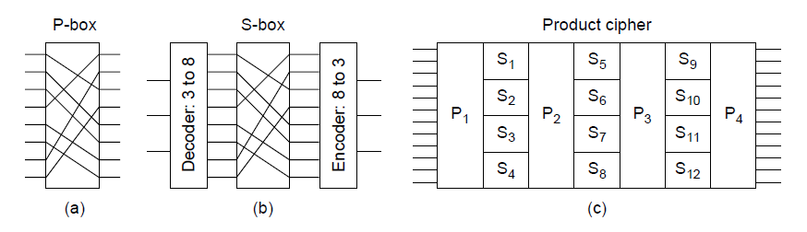
Symmetric-key Algorithms (1)
Basic elements of product ciphers.
(a) P-box. (b) S-box. (c) Product.

Slide 41
Symmetric-key Algorithms (2)
Data encryption standard
Advanced encryption standard
Cipher modes
Other ciphers
Cryptanalysis

Slide 42
Symmetric key crypto: DES
DES operation
initial permutation
16 identical “rounds” of function application, each using different 48 bits of key
final permutation

Slide 43
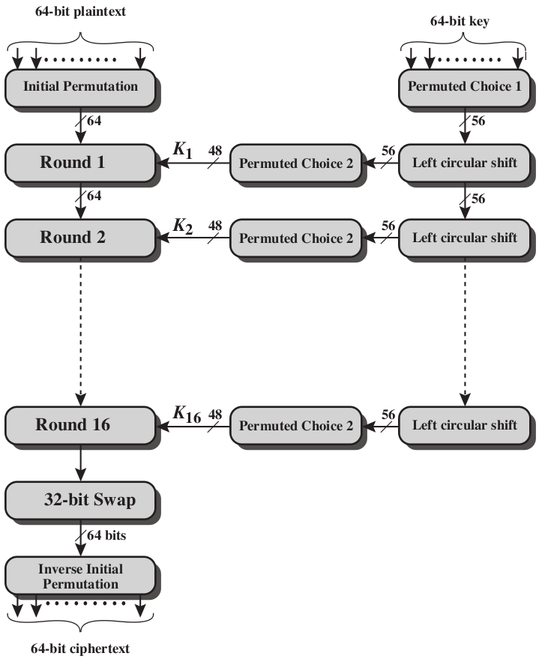
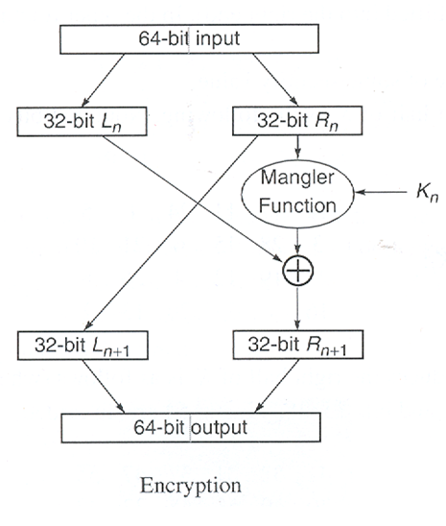
DES Encryption Algorithm Overview
16 rounds using 64-bit block and 48-bit subkey
1.Initial/Final Permutation
2.Round Function
3.Sub-key Generation
Round

Slide 44
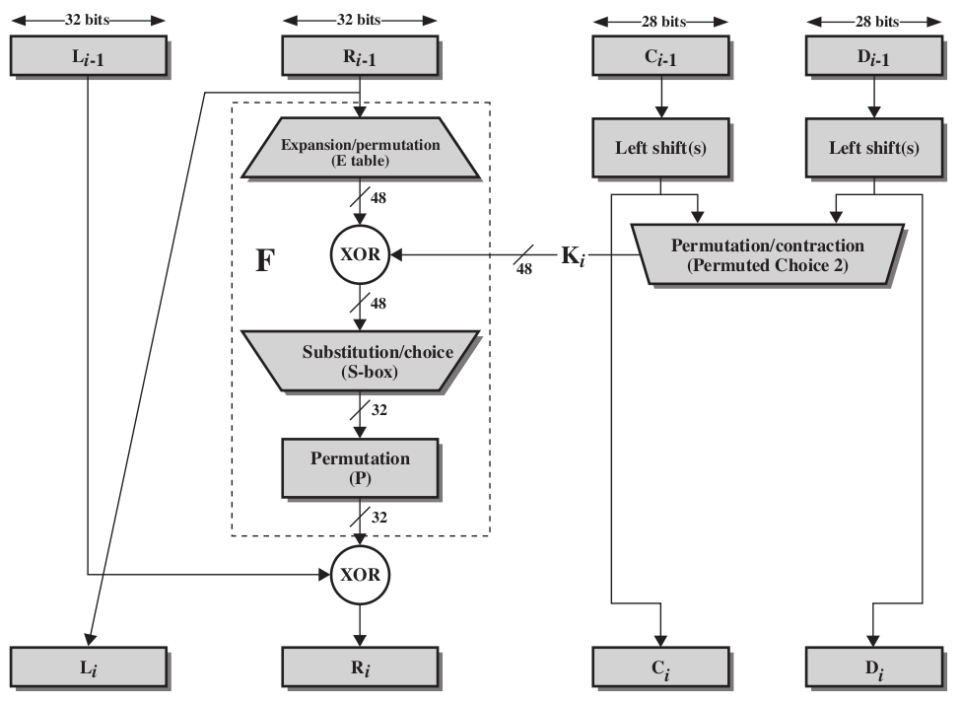
Single Round of DES Algorithm

Slide 45
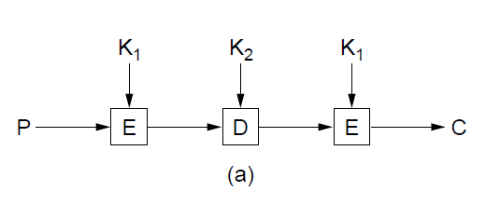
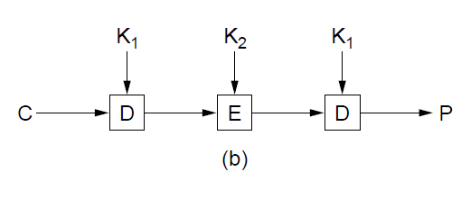
Data Encryption Standard (2)
(a) Triple encryption using DES. (b) Decryption

Slide 46



Symmetric key crypto: DES
Original
Without cipher-block chaining
With cipher-block chaining

Slide 47
Advanced Encryption Standard (1)
Algorithm symmetric block cipher.
Full design must be public.
Key lengths of 128, 192, and 256 bits supported.
Software and hardware implementations possible.
Algorithm public or licensed on nondiscriminatory terms.

Slide 48
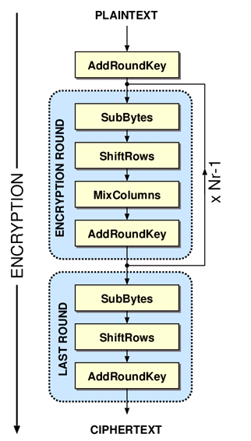
Basic Structure of AES
# Rounds Nr = 6 + max{N_{b}, N_{k}}
N_{b} = 32-bit words in the block
N_{k} = 32-bit words in key
AES-128: 10
AES-192: 12
AES-256: 14

Slide 49
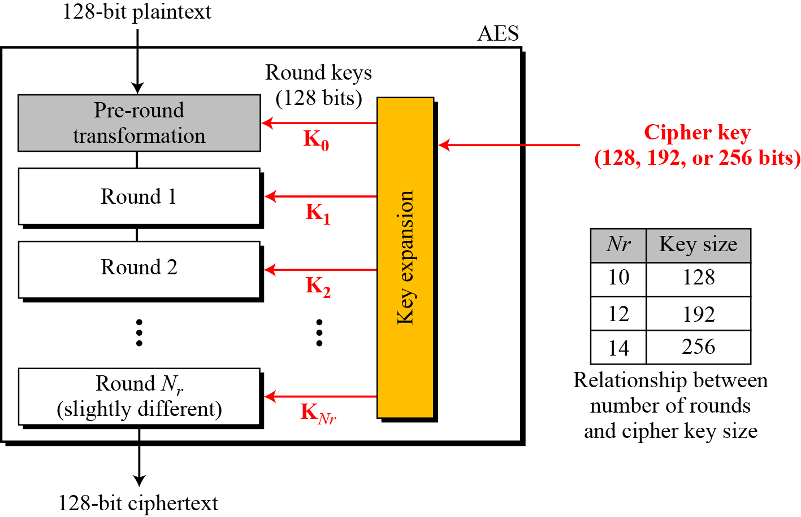
Cont.
General design of AES encryption cipher

Slide 50
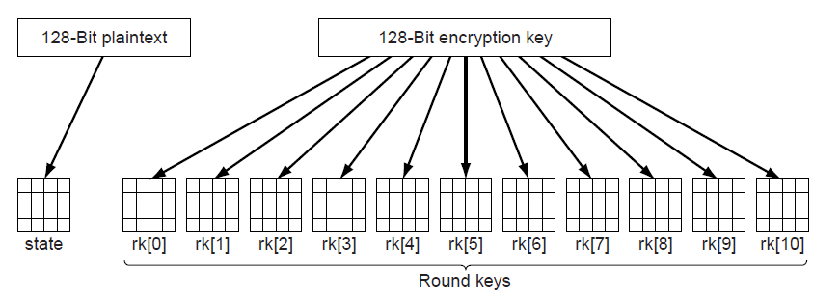
Advanced Encryption Standard (2)
Creating of the state and rk arrays

Slide 51
USE OF MODERN BLOCK CIPHERS
Symmetric-key encipherment can be done using modern block ciphers. Modes of operation have been devised to encipher text of any size employing either DES or AES.
Topics
Electronic Codebook (ECB) Mode
Cipher Block Chaining (CBC) Mode
Cipher Feedback (CFB) Mode
Output Feedback (OFB) Mode
Counter (CTR) Mode

Slide 52
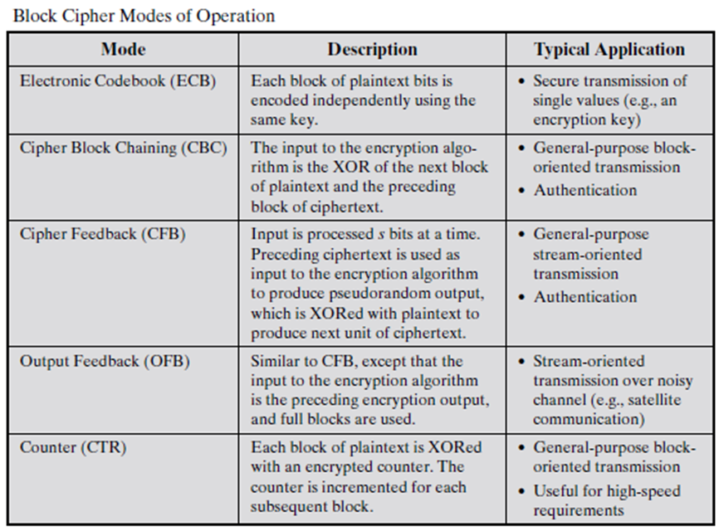
8.<number>

Slide 53
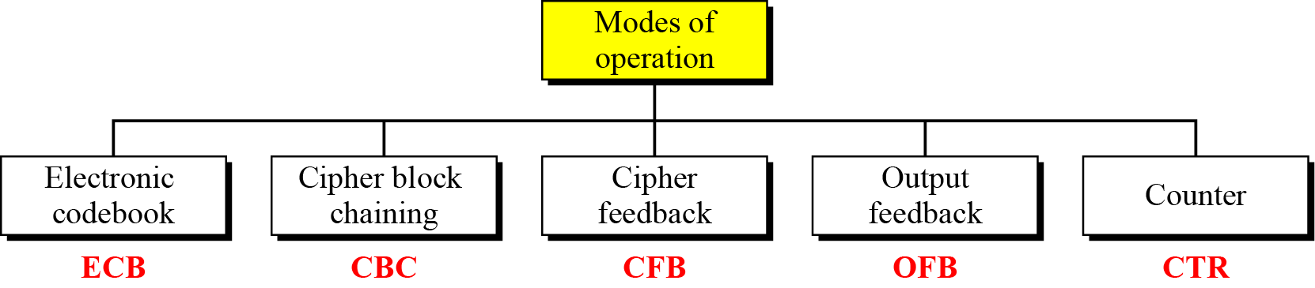
Continued
Figure Modes of operation

Slide 54
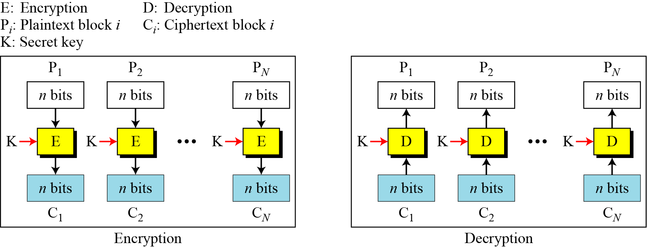
Electronic Codebook (ECB) Mode
The simplest mode of operation is called the electronic codebook (ECB) mode.
Figure Electronic codebook (ECB) mode

Slide 55
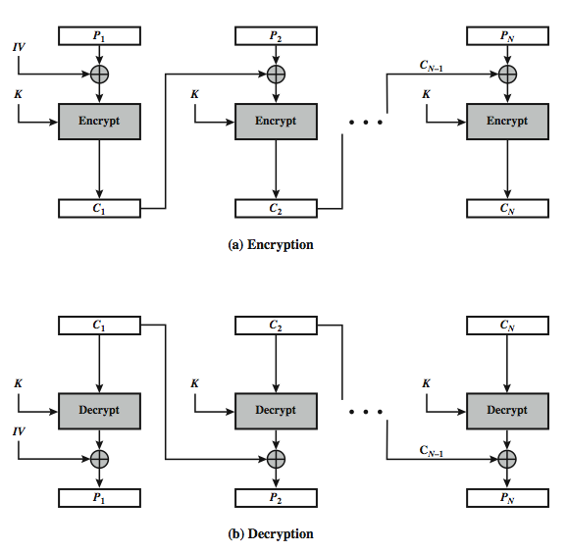
Cipher Block Chaining (CBC) Mode

Slide 56
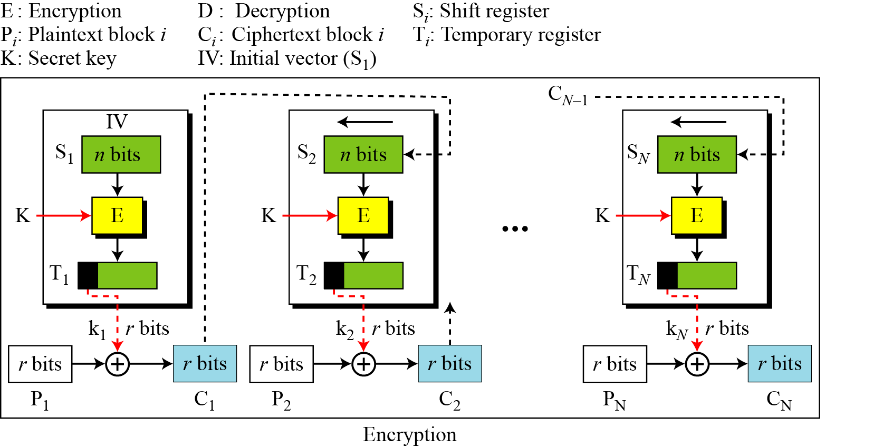
Cipher Feedback (CFB) Mode
In some situations, we need to use DES or AES as secure ciphers, but the plaintext or ciphertext block sizes are to be smaller.
Figure Encryption in cipher feedback (CFB) mode

Slide 57
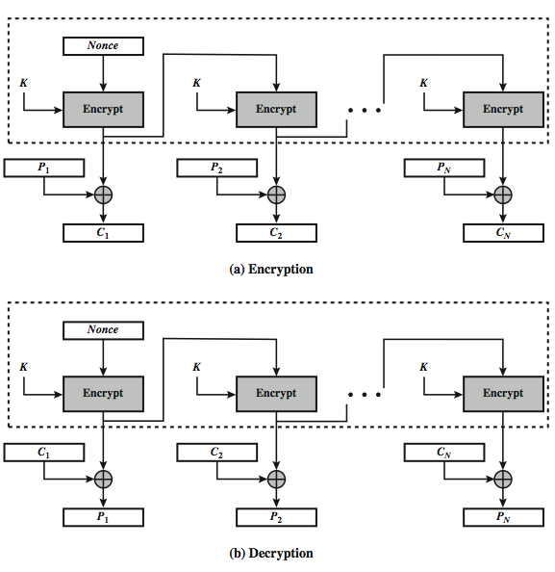
Output FeedBack (OFB)

Slide 58
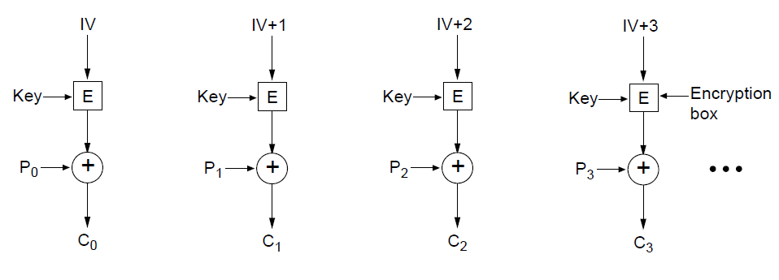
Cipher Modes
Encryption using counter mode

